Slide 1
Classification and clustering of bank data using Hadoop, pig and r
GUIDED BY,
Dr.S.BALAKRISHNAN,
Department of Information Technology,
SKCET.
PROJECT SUBMITTED BY,
AGILAN S 15EUIT003
ARUN KUMAR A K 15EUIT011
FAHEEN FATHIMA B N 15EUIT030
VINITHA B 16EUIT518

Slide 2
PROBLEM STATEMENT
Based on the current salary, assets owned by the customers may not help to classify the customers accurately.
Customers with valuable assets and good salary may show reluctance to payback loans
Customers with not much valuable assets and an average salary may pay the loans properly
Hence understanding the behaviour / nature customers become tedious for the banks.

Slide 3
OBJECTIVES
To classify the customers based on their previous transactions(not only on current salary and assets)
To categorize them into low, medium and high risk customers.
To decide if the holder can be approved of the credit card and loans
To enables banks to do marketing by understanding their customers.
To enable the banks to identify the target customers.

Slide 4
Literature survey
Ivanilton Polato a,b,n , Reginaldo Ré b , Alfredo Goldman a , Fabio Kon” A comprehensive view of Hadoop research—A systematic literature review”

Slide 5
BASE PAPER
2017 IEEE International Conference on Big Data (BIGDATA) PrathyushaRani Merla Yiheng Liang Department of Computer Science Department of Computer Science Bridgewater State University Bridgewater State University Bridgewater, MA, USA Bridgewater, MA, USA
Data Analysis using Hadoop MapReduce Environment

Slide 6
BASE PAPER
Feng Li, Beng Chin Ooi, M. Tamer Ozsu, and Sai Wu. 2014. Distributed data management using MapReduce. ¨ ACM Comput. Surv. 46, 3, Article 31 (January 2014), 42 pages. DOI: http://dx.doi.org/10.1145/2503009

Slide 7
BASE PAPER
International Conference on Information Security & Privacy (ICISP2015), 11-12 December 2015,Nagpur, INDIA “Crime Data Analysis Using Pig with Hadoop”Arushi Jaina, Vishal Bhatnagara Ambedkar Institute of Advanced Communication Technologies and Research, New Delhi

Slide 8
10.1109/I-SMAC.2017.8058297

Slide 9
EXISTING SYSTEM
“According to RBI statistics, a bank can handle 8,00,00,000 transactions in a single month”
Traditional client server architecture is being used to analyse the customer patterns which is less accurate and inefficient.
Considering the advances in recent technologies and high amount of data that is being processed, there can be a better way of analysing the customer behaviour.

Slide 10
PROPOSED SYSTEM CONCEPT
Using Hadoop ecosystem to perform analysis over the bank customer data
Classifying customers into High, Medium and Low risk customers.
Clustering and analysing the clusters for better accuracy.
Classification using Hadoop framework and Apache Pig
Clustering and analysis using R Programming

Slide 11
Proposed system context diagram

Slide 12
Proposed system system architecture

Slide 13
modules
Preprocessing Data
Creating relationships and tables
Classification of data
Clustering data

Slide 14
DATA FLOW DIAGRAM
MODULE 1
MODULE 2
MODULE 3
MODULE 4
Load into HDFS
Relationships
Extract data
Cluster data
Bank data
Create table
User

Slide 15
Preprocessing Data MODULE 1
Loading and Preprocessing
Raw Data
Processed Data
INPUT – Dataset in Ascii format
OUTPUT – Data in an .csv format
PROCESS -
Load data into HDFS
Use Apache pig commands to clean data

Slide 16
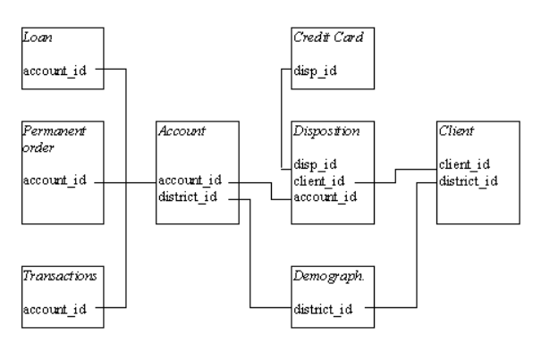
Establishing relationships and creating tables Module 2
Establish relationships
Processed Data
Formatted tables
INPUT - .csv files
OUTPUT - Tables
PROCESS - Pig Latin queries on creating relationships and tables

Slide 17
Extracting data module 3
Apply constraints
Table Data
Classified Data
Parameters considered
Transaction amount
Loan status
Credit card status
Average salary
Age
Unemployment rate
Entrepreneurship rate
Disposition
METHOD
INPUT - Formatted tables
OUTPUT - Three datasets containing high, medium and low risk customers
PROCESS –
Establish query statements using Latin
Classify data into three sets namely high, low and medium risk customers.
Store it into the HDFS

Slide 18

Clustering data Module 4
Clustering in R
Classified Data
Clustered data
K-Means clustering-Formula
METHOD
INPUT - Classified data
OUTPUT - Clustered data
PROCESS –
Load data into R Studio
Cluster using K-means Algorithm
Plot graphs for interface
||x_{i} - v_{j}|| is Eucledian Distance
Ci is number of datapoints in ‘i’ cluster
C cluster centers

Slide 19
pseudocode
Convert ascii files into .csv files
Load into the HDFS of Hadoop Framework
Integrate Pig with HDFS
Join tables corresponding to the constraints
Classify data into three datasets for high, medium and low risk customers using the parameters in Latin language
Load the data into R-Studio
Apply K-means Algorithm
Plot the datasets into a graph

Slide 20
Advantages
Understanding the customer behaviour of a bank.
Analysing the bank data to provide useful behaviour.
Improves the decision making of banks regarding the schemes and loan/credit cards.
Provides graphical and analytical approach towards understanding the customer behaviour.
Identification of target customers.

Slide 21
disadvantages
Having knowledge about Hadoop framework and R programming.
Understanding the bank requirements regarding the provision of schemes and loan/credit cards.
Multi node Hadoop cluster should be set up to implement in real-time scenario.
Does not provide significant difference in case of small datasets.

Slide 22
requirements
Software Requirements
VM ware workstation
Cloudera OS
Hadoop utilities with Apache Pig
R Studio
Eclipse with Maven plugins
Hardware Requirements
Windows 7/8/10 or Unix platform
Minimum 4Gb RAM

Slide 23
references
[1] https://www.researchgate.net/publication/329402555
[2] https://www.tutorialspoint.com/apache_pig/apache_pig_user_defined_functions.htm
[3] https://www.tutorialspoint.com/apache_pig
[4] https://www.edureka.co/big-data-and-hadoop
[5] https://www.statmethods.net/r-tutorial/index.html
[6] https://www.dezyre.com/article/difference-between-pig-and-hive-the-two-key-components-of-hadoop-ecosystem/79
[7] https://www.hadoop360.datasciencecentral.com/blog/pig-vs-hive-vs-sql-difference-between-the-big-data-tools

